Slide 1
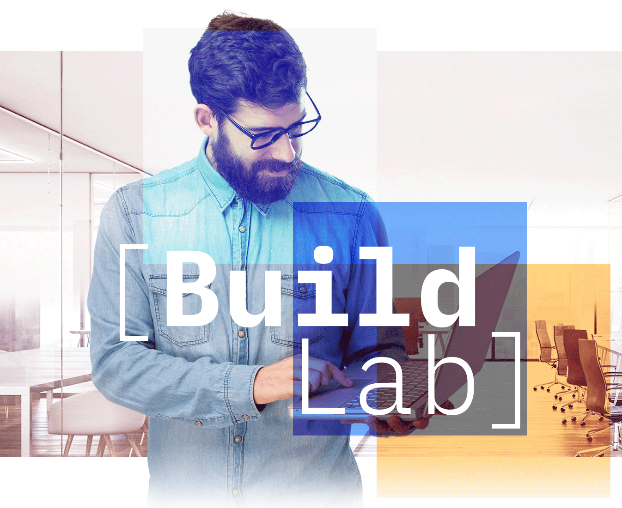


[Ecosystem Engineering | Build Lab Americas]
Scalewith PoC Architecture
ScaleWith
Social Impact AI

Slide 2

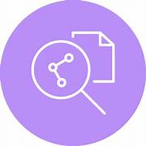



Revised PoC Architecture
Multi-stage RAG
Model A
Model B
Model C
S# | Stage 1 RAG
1 | Stage 1 search retrieval
2 | Invoke LLM for mapping inference
3 | Use the most suite model for the task
4 | Model response received by the service
5 | New document with sufficient enrichment posted into Discovery
 | Stage 2 RAG (Conversation Search)
6 | Questions from Scalewith customers
7 | Stage 2 search retrieval
8 | Invoke LLM for mapping inference
3 | Assistant uses its embedded LLM
9 | Response as inferred by Watsonx LLM
12 | Response sent back to customer
-3-
-4-
-5-
-2-
Scheduled Service
-1-
watsonx.ai
Watson
Discovery
-9-
-8-
-6-
-10-
-7-
Watson
Assistant

Slide 3
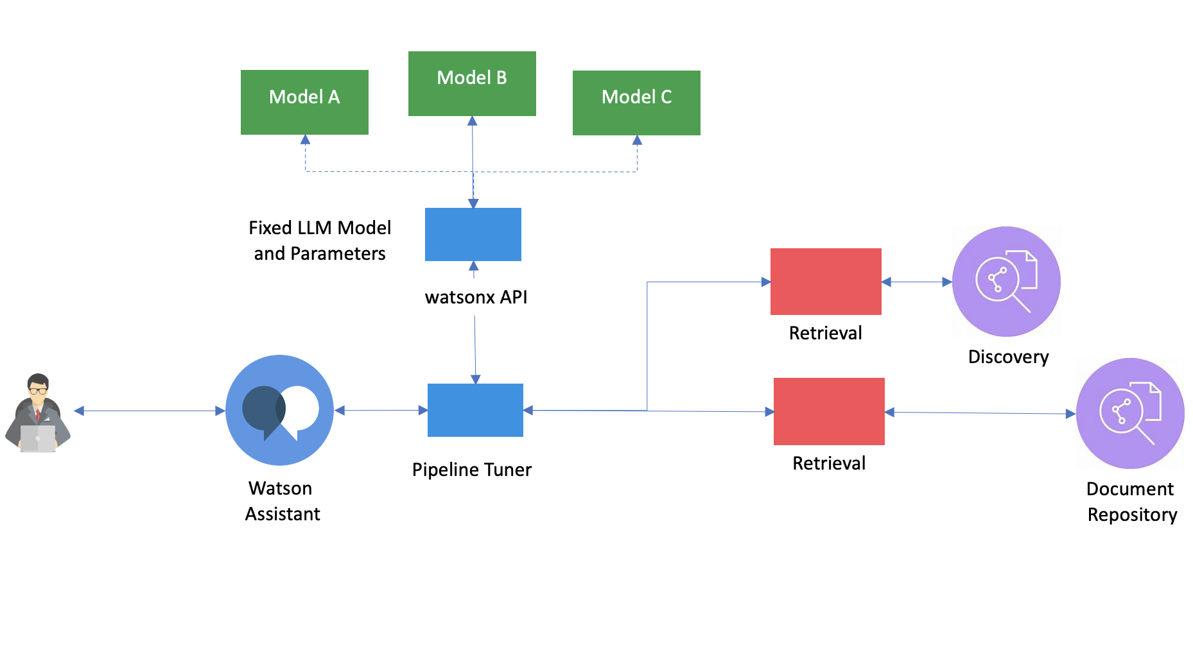
[Ecosystem Engineering | Build Lab Americas]
[Partner logo]
Proposed Architecture
Type of Engagement: PoC
Architecture details:
Application Name = “Social Impact AI”
As part of discovery session, Build Lab to work with ScaleWith business and development team to construct application architecture. ScaleWith would outline the intended user experience and approach, and IBM/Build Lab would develop the use case with the IBM Watsonx offerings as required.
Assumption: ScaleWith will embed the Watson services running on IBM Cloud.

